Slide 1
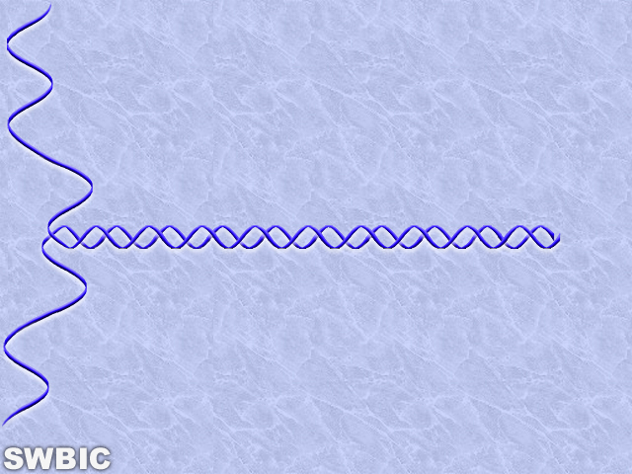
Genome Sequencing,
Fragment Assembly, and the use of
Consed, Phred, and Phrap
Oliver Hampton
The Southwest Biotechnology & Informatics Center (SWBIC)
With Co-Authors Phuc Nguyen and Alessandro Dal Palú
New Mexico State University

Slide 2

Molecular Biology Review

Slide 3
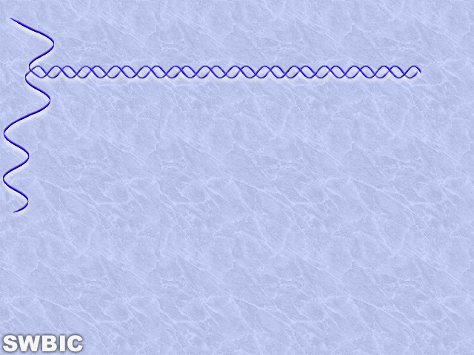
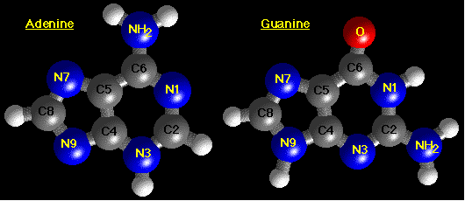
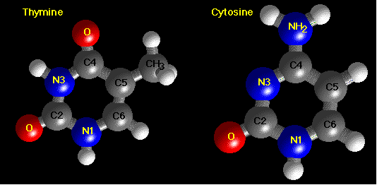
DNA Base Structure
Structure of A & G (Purines)
Structure of T & C (Pyrimidines)

Slide 4
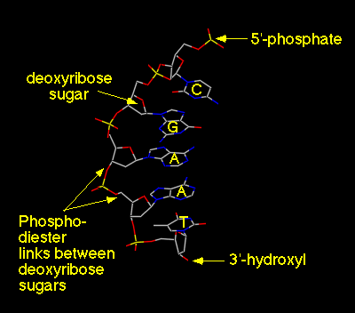
DNA Backbone: 5’-d(CGAAT)
Alternating backbone of deoxyribose and phosphodiester groups
Chain has a direction (known as polarity), 5'- to 3'- from top to bottom
Oxygens (red atoms) of phosphates are polar and negatively charged
A, G, C, and T bases extend away from chain, and stack on-top each other
Bases are hydrophobic

Slide 5
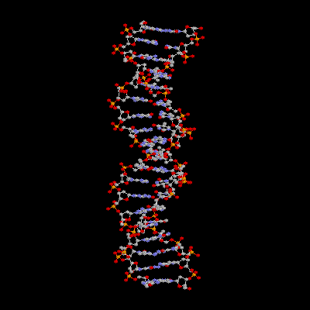
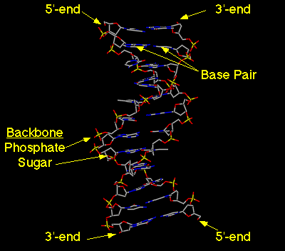
DNA Double Stranded Structure

Slide 6
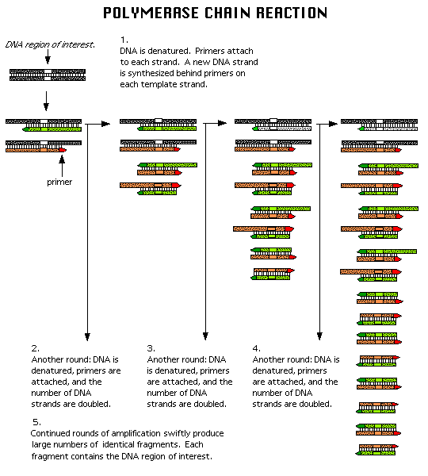
Polymerase Chain Reaction

Slide 7
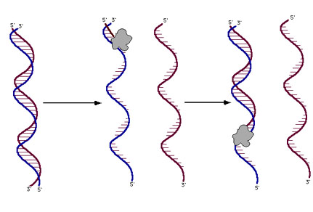
DNA Sequencing Reactions
The DNA sequencing rxn is similar to the PCR rxn.
The rxn mix includes the template DNA, Taq polymerase, dNTPs, ddNTPs, and a primer: a small piece of single-stranded DNA 20-30 nt long that hybridizes to one strand of the template DNA.
The rxn is intitiated by heating until the two strands of DNA separate, then the primers anneals to the complementary template strand, and DNA polymerase elongates the primer.

Slide 8
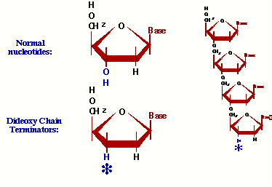
Dideoxynucleotides
In automated sequencing ddNTPs are fluorescently tagged with 1 of 4 dyes that emit a specific wavelength of light when excited by a laser.
ddNTPs are chain terminators because there is no 3’ hydroxy group to facilitate the elongation of the growing DNA strand.
In the sequencing rxn there is a higher concentration of dNTPs than ddNTPs.

Slide 9
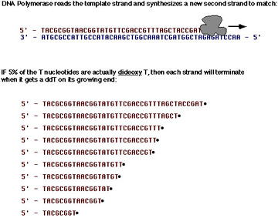
DNA Replication in the Presence of ddNTPs
DNA replication in the presence of both dNTPs and ddNTPs will terminate the growing DNA strand at each base.
In the presence of 5% ddTTPs and 95% dTTPs Taq polymerase will incorporate a terminating ddTTP at each ‘T’ position in the growing DNA strand.
Note: DNA is replicated in the 5’ to 3’ direction.

Slide 10
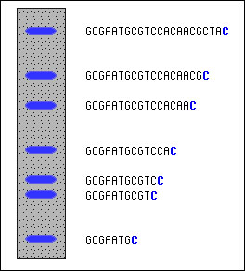
Gel Electrophoresis DNA Fragment Size Determination
DNA is negatively charged because of the Phosphate groups that make up the DNA Phosphate backbone.
Gel Electrophoresis separates DNA by fragment size. The larger the DNA piece the slower it will progress through the gel matrix toward the positive cathode. Conversely, the smaller the DNA fragment, the faster it will travel through the gel.

Slide 11
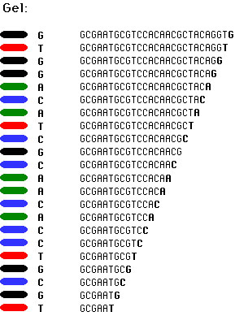
Putting It All Together
Using gel electrophoresis to separate each DNA fragment that differs by a single nucleotide will band each fluorescently tagged terminating ddNTP producing a sequencing read.
The gel is read from the bottom up, from 5’ to 3’, from smallest to largest DNA fragment.

Slide 12
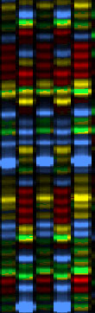
Raw Automated Sequencing Data
A 5 lane example of raw automated sequencing data.
Green: ddATP
Red: ddTTP
Yellow: ddGTP
Blue: ddCTP

Slide 13
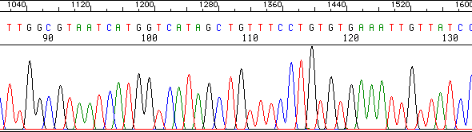
Analyzed Raw Data
In addition to nucleotide sequence text files the automated sequencer also provides trace diagrams.
Trace diagrams are analyzed by base calling programs that use dynamic programming to match predicted and occurring peak intensity and peak location.
Base calling programs predict nucleotide locations in sequencing reads where data anomalies occur. Such as multiple peaks at one nucleotide location, spread out peaks, low intensity peaks.

Slide 14
Sequencing Strategies
Map-Based Assembly:
  Create a detailed complete fragment map
  Time-consuming and expensive
  Provides scaffold for assembly
  Original strategy of Human Genome Project
Shotgun:
  Quick, highly redundant – requires 7-9X coverage for sequencing reads of 500-750bp. This means that for the Human Genome of 3 billion bp, 21-27 billion bases need to be sequence to provide adequate fragment overlap.
  Computationally intensive
  Troubles with repetitive DNA
  Original strategy of Celera Genomics

Slide 15
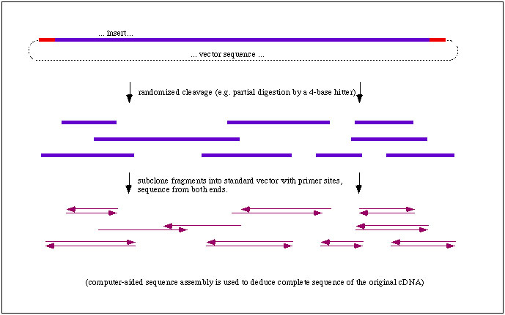
Shotgun Sequencing: Assembly of Random Sequence Fragments
To sequence a Bacterial Artificial Chromosome (100-300Kb), millions of copies are sheared randomly, inserted into plasmids, and then sequenced. If enough fragments are sequenced, it will be possible to reconstruct the BAC based on overlapping fragments.

Slide 16
DNA Fragment Assembly and the
Consed, Phred & Phrap
UNIX Package

Slide 17
Consed, Phred & Phrap
Overview
Developed at the University of Washington
  Phil Green (phrap)
  Brent Ewing (phred)
  David Gordon (consed)
http://www.phrap.org/index.html

Slide 18
Consed, Phred & Phrap
UNIX (free to academic users) DNA assembly package for high through-put sequencing projects.
Consed: graphical interface extension that controls both Phred and Phrap.
Phred: base calling, vector trimming, end of sequence read trimming.
Phrap: assembler
  Phrap uses Phred’s base calling scores to determine the consensus sequences. Phrap examines all individual sequences at a given position, and uses the highest scoring sequence (if it exists) to extend the consensus sequence.

Slide 19
More on Phrap
Phrap constructs the contig sequence as a mosaic of the highest quality parts of the reads rather than as a statistically computed “consensus”. This avoids both the complex algorithm issues associated with multiple alignment methods, and problems that occur with these methods causing the consensus to be less accurate than individual reads at some positions.
The sequence produced by Phrap is quite accurate: less than 1 error per 10 kb in typical datasets.
Sequence quality at a given position is determined by the Phred base caller.

Slide 20
Consed
Graphical User Interface

Slide 21
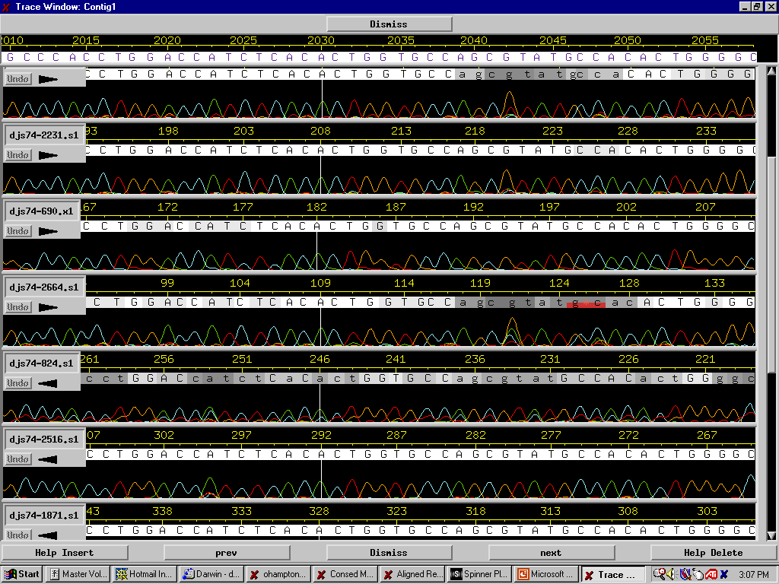
Trace Sequence Reads After Phred: Base Calling

Slide 22
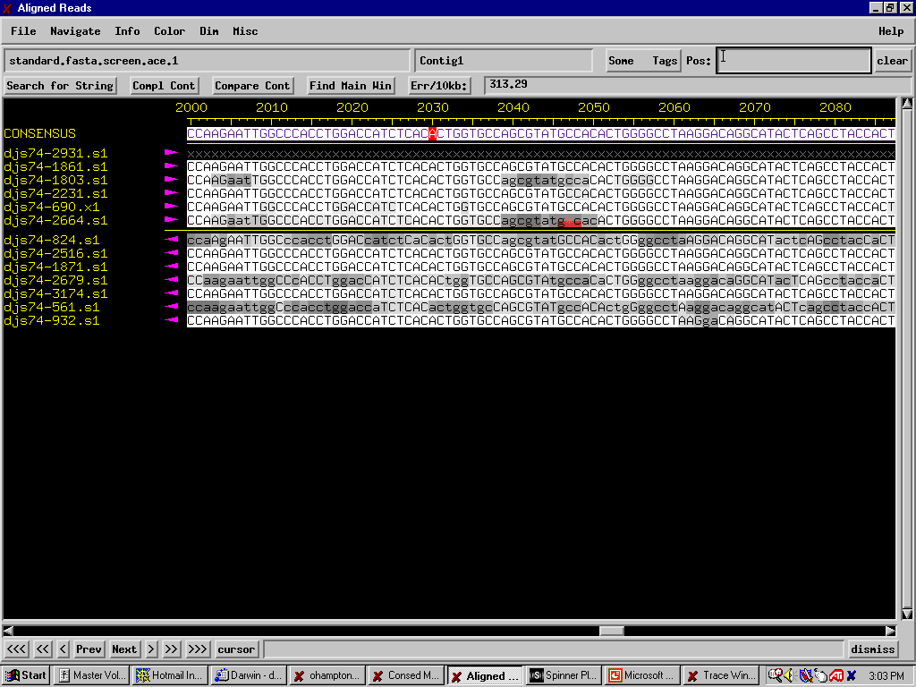
Consed: Graphical Alignment Representation

Slide 23
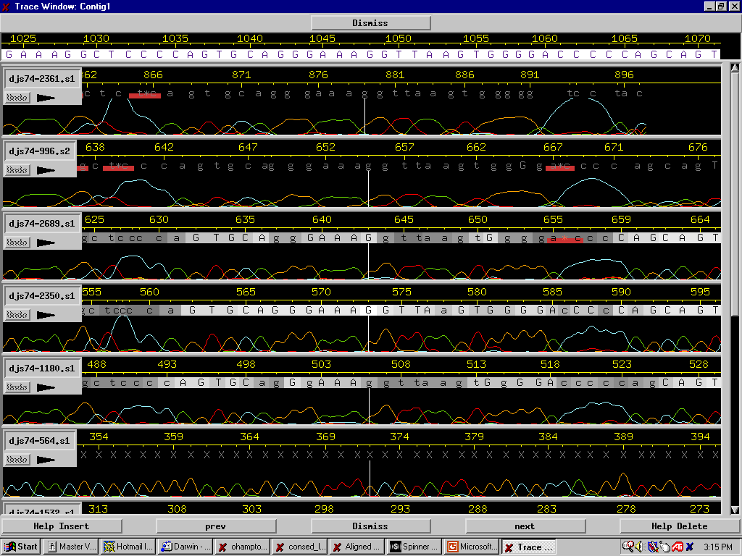
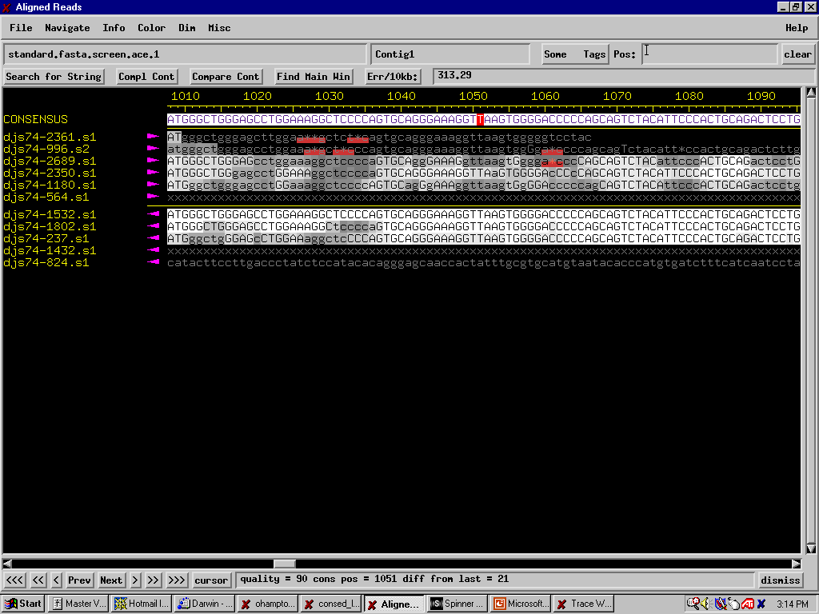
Poor Trace Sequence Data and Corresponding Phred Basecalling

Slide 24
Phred
Base Calling

Slide 25
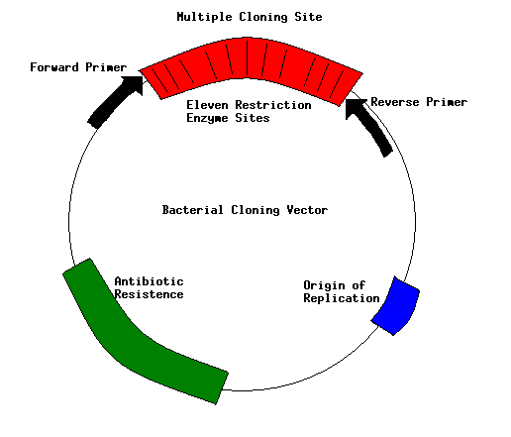
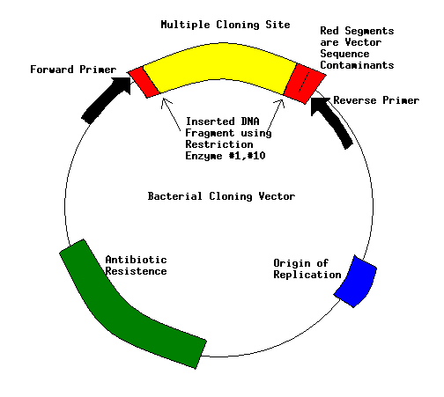
Vector Trimming

Slide 26
Vector Trimming (Continued)
Trimming of the vector sequence to yield only the insert DNA is an example of finding the longest prefix in S (raw sequence data) that is an exact match in T (Vector Multiple Cloning Site sequence).
Let S’ = S $ T, where ‘$’ is a unique character. Using Fundamental Preprocessing and the calculation of all Z-Boxes in S’, we choose the largest Z-Box that occurs in T and obtain its length to trim from the 5’ end of S.

Slide 27
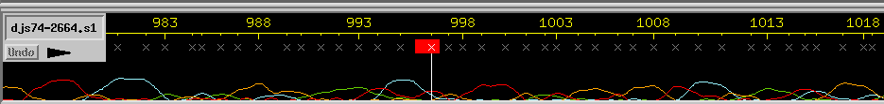
End of Sequence Cropping
It is common that the end of sequencing reads have poor data. This is due to the difficulties in resolving larger fragment ~1kb (it is easier to resolve 21bp from 20bp than it is to resolve 1001bp from 1000bp).
Phred assigns a non-value of ‘x’ to this data by comparing peak separation and peak intensity to internal standards. If the standard threshold score is not reached, the data will not be used.

Slide 28
What is Phred?
Phred is a program that observes the base trace, makes base calls, and assigns quality values (qv) of bases in the sequence.
It then writes base calls and qv to output files that will be used for Phrap assembly. The qv will be useful for consensus sequence construction.
For example, ATGCATTC string1
CGTTCATGC string2
ATGC-TTCATGC superstring
Here we have a mismatch ‘A’ and ‘G’, the qv will determine the dash in the superstring. The base with higher qv will replaces the dash.

Slide 29
Why Phred?
Output sequence might contain errors.
Vector contamination might occur.
Dye-terminator reaction might not occur.
Segment migration abnormal in gel electrophoresis.
Weak or variable signal strength of peak corresponding to a base.

Slide 30
How Phred calculates qv?
From the base trace Phred know number of peaks and actual peak locations.
Phred predicts peaks locations.
Phred reads the actual peak locations from base trace.
Phred match the actual locations with the predicted locations by using Dynamic Programming.
The qv is related to the base call error probability (ep) by the formula qv = -10*log_10(ep)

Slide 31
Phred Code
BEGIN
Row 0 holds predicted values
Column 0 holds actual values
for i=1 to n do
for j=1 to n do
if D(0,j)=D(i,0)
D(i,j)=0
else if |D(0,j)-D(i,0)| >= 1 then
D(i,j)= min[D(i-1,j)+1, D(i,j-1)+1)]
else
D(i,j)=|D(0,j)-D(i,0)|
END

Slide 32
Example 1
0 | 1(A) | 2 (G) | 3(C) | 4(A) | 5(T)
1 | 0 | 1 | 2 | 3 | 4
2.1 | 1 | 0.1 | 0.9 | 1.9 | 2.9
2.9 | 2 | 0.1 | 0.1 | 1.1 | 2.1
4 | 3 | 1.9 | 1.1 | 0 | 1
5 | 4 | 2.9 | 2.1 | 1 | 0

Slide 33
Output from example 1
Sequence | A | G | C | A | T
Error Probability | 0 | 0.1 | 0.1 | 0 | 0
Quality value | 99 | 10 | 10 | 99 | 99
Quality value rank from 0 to 99
0-4 is given by dark gray.
5-14 is given by a shade lighter.
15-99 is given by white (bright shade).

Slide 34
Example 2
0 | 1 (A) | 2 (G) | 3 (C) | 4 (A) | 5 (T)
1 | 0 | 1 | 2 | 3 | 4
3 | 1 | 1 | 0 | 1 | 2
4 | 2 | 2 | 1 | 0 | 1
5 | 3 | 3 | 2 | 1 | 0
8 | 4 | 4 | 3 | 2 | 1

Slide 35
Output from Example 2
The last base is removed.
A base is added to the second place.
Output:
Sequence A c G C A
Quality value 99 0 99 99 99
the added base has quality value of zero.

Slide 36
Phrap
Fragment Assembly

Slide 37
Sequence Reconstruction Algorithm
In the shotgun approach to sequencing, small fragments of DNA are reassembled back into the original sequence. This is an example of the Shortest Common Superstring (SCS) problem where we are given fragments and we wish to find the shortest sequence containing all the fragments.
A superstring of the set P is a single string that contains every string in P as a substring.
For example: for The SCS is: GGCGCC
F1 = GCGC F1 = GCGC
F2 = CGCC F2 = CGCC
F3 = GGCG F3 = GGCG

Slide 38
Greedy Algorithm for the Shortest Superstring Problem
The shortest superstring problem can be examined as a Hamiltonian path and is shown to be equivalent to the Traveling Salesman problem. The shortest superstring problem is NP-complete.
A greedy algorithm exists that sequentially merges fragments starting with the pair with the most overlap first.
  Let T be the set of all fragments and let S be an empty set.
  do {
  For the pair (s,t) in T with maximum overlap. [s=t is allowed]
  {
  If s is different from t, merge s and t.
  If s = t, remove s from T and add s to S.
  }
  } while ( T is not empty );
  Output the concatenation of the elements of S.
This greedy algorithm is of polynomial complexity and ignores the biological problems of: which direction a fragment is orientated, errors in data, insertions and deletions.

Slide 39
Phrap Preprocessing Steps
Read in sequence and quality data, trim off low quality ends of reads, construct read complements
Find pairs of reads with matching words. Eliminate exact duplicate reads. Perform Smith-Waterman pairwise alignments on pairs with matching words.
Find vector matches and mark so that they are not used in assembly.
Find and combine near duplicate reads.
Dissolve matching read pairs that do not have “solid” matching segments or self-matches.

Slide 40
Smith-Waterman Scoring
SWi,j = max{SW_{i-1,j-1}+s(a_{i},b_{j}); SW_{i-k,j} + g_{j}; SW_{i,j-k}+g_{i}; 0}
  SW_{i,j} is the score of the partial alignment of sequence a ending at residue i and sequence b ending at residue j
The score is taken as the maximum of the 4 terms
SW_{i-1,j-1}+s(a_{i},b_{j}) = extends the alignment by one residue in each sequence
SW_{i-k,j} + g_{j} = extends to j in sequence b and inserts a single matching gap in sequence a
SW_{i,j-k}+ g_{i} = extends to i in sequence a and inserts a single matching gap in sequence b
0 = ends the alignment if the score falls below zero

Slide 41
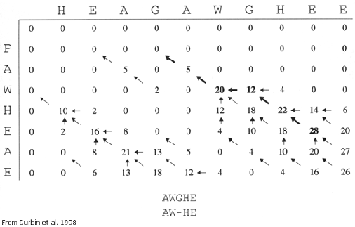
Smith-Waterman Algorithm
Assigns a score to each pair of bases
  Uses similarity scores only
  Uses positive scores for related residues
  Uses negative scores for substitutions and gaps
Initializes edges of the matrix with zeros
As the scores are summed in the matrix, any score below zero is recorded as zero
Begins the trace back at the maximum value found anywhere in the matrix
Continues until the score falls to zero

Slide 42
Phrap Iterative Steps
6. Use pairwise matches to identify confirmed parts of reads; use these to compute revised quality values.
7. Compute LLR scores for each match.
  LLR score is a measure of overlap length and quality. High quality discrepancies that might indicate different copies of a repeat lead to low LLR scores.

Slide 43
Phrap Steps (Continued)
8. Find best alignment for each matching pair of reads that have more than one significant alignment in a given region (highest LLR-scores among several overlapping).
9. Construct contig layouts, using consistent pairwise matches in decreasing score order (greedy algorithm).
10. Construct contig sequence as a mosaic of the highest quality parts of the reads.
11. Align reads to contig; tabulate inconsistencies and possible sites of misassembly. Adjust LLR-scores of contig sequence.

Slide 44
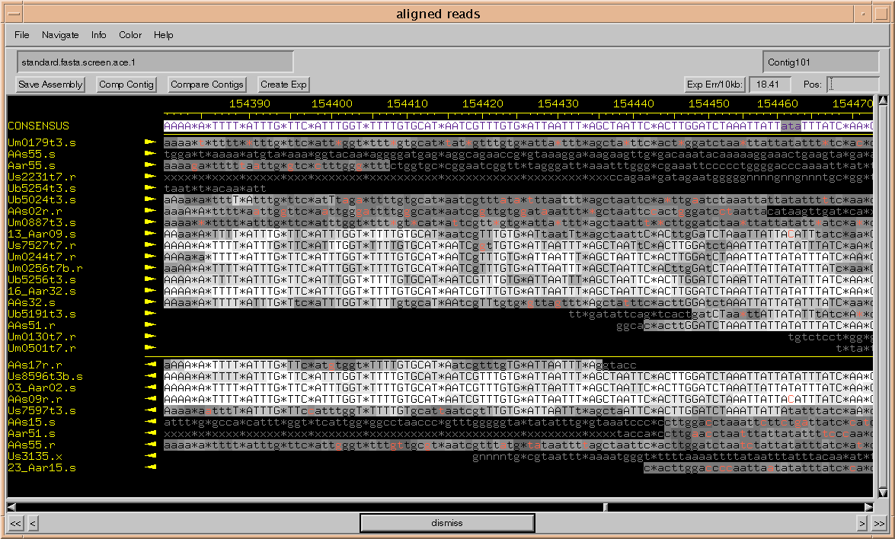

Slide 45
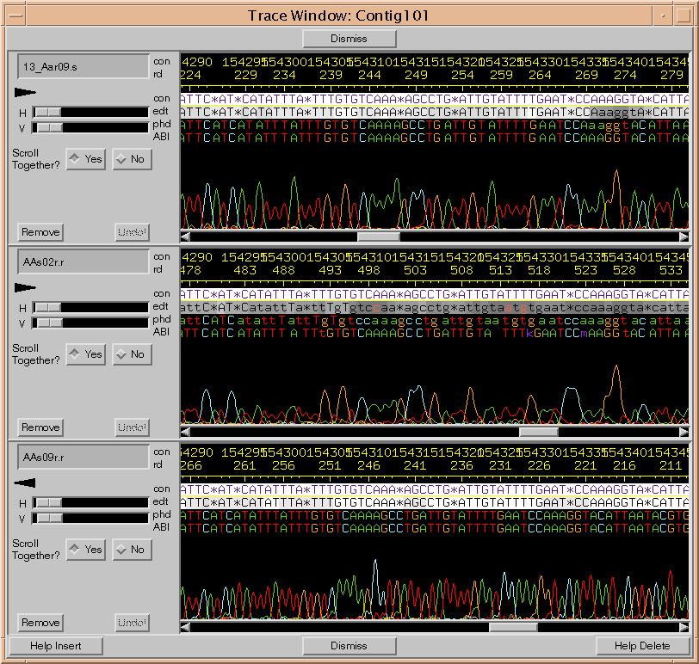

Slide 46
Accessory
Overlap
Slides

Slide 47
What is an Overlap?
1.
These
are
2.
overlaps
3.
4.
These
are not
5.
overlaps
6.

Slide 48
Calculating an Overlap
Word Size (* 7 *)
  Word Size: is the shorted non-gapped local pairwise alignment allowed.
Stringency (* 0.80 *)
  What fraction of words must match?
Minimum overlap length (* 14 *)
Denotes: * user defined variables * or
* Phrap default values *

Slide 49
Overlap
Sequence 2
1
125
1
Sequence 1
200

Slide 50
Overlap Plot
125
Sequence
2
1
Sequence 1
200

Slide 51
References
Bethesda, M.D., “New Tools for Tomorrow’s Health Research,” National Center for Human Genome Research, Department of Health and Human Services, 1992.
Chen, T., Skiena, S., “A Case Study on Genome-Level Fragment Assembly,” Bioinformatics, 16:494-500, 2000.
Durbin, Eddy, Krogh, and Mitchison, Biological Sequence Analysis: Probabilistic Models of Proteins and Nucleic Acids, Cambridge University Press, 1998.
Gordon, D., Abajian C., and Green P., “Consed: A Graphical Tool for Sequence Finishing,” Genome Research, 8:195-202.
Gusfield, Algorithms on Strings, Trees, and Sequence: Computer Science and Computational Biology, Cambridge University Press, 1997.
Waterman, Michael, Introduction to Computational Biology, London University Press, 1995.
www.phrap.org
www.blc.arizona.edu/Molecular_Graphics
www.swbic.org

